Slide 1



Kenya Nutrition Monitoring & Evaluation Framework
The Kenya Nutritionn Information Technical Working Group
NITWG

Slide 2

2022 Kenya Nutrition Action Plan
Chapter 6: Monitoring, Evaluation, Accountability And Learning (MEAL)
Key Result Area 16: Sectoral and multisectoral nutrition information systems, learning and research strengthened: Review and update the Kenya Nutrition M&E framework
Nutrition M&E Framework
Provide one agreed country level nutrition M&E framework for the 2018-2022 KNAP
Facilitate tracking and evaluation of performance of set targets
Serve as an accountability and learning framework
Provides indicators that will be mutually tracked and reported by all sectors responsible for the implementation of KNAP

Slide 3
Content Overview
Chapter 1: Introduction
Nutrition Situation
Vision, Mission and Mandate of Division of Nutrition and Dietetics (DND)
DND Core Values and Guiding Principles
The Kenya Nutrition Action Plan 2018-2022 and County nutrition Action Plans
Development process of the Monitoring and Evaluation Framework 2018-2022
Status of nutrition M&E and information system
Chapter 2: Development of the Nutrition Monitoring and Evaluation Framework
Rationale
Goal and Objectives of the M&E Framework
Guiding Principles for the M&E framework
M&E Toolkit
Basic Concepts of Monitoring, Evaluation, Accountability and Learning
Sources of nutrition data and information
Components of the Nutrition Information System
Chapter 3: Nutrition M&E Framework In Kenya
Common Results Accountability Framework
Indicators by Key Result Areas
Monitoring and Reporting
Monitoring and Evaluation Implementation Matrix
Evaluation
Accountability and Learning
Operational Research
Research and Learning Implementation Matrix
Chapter Four: Implementation Strategy for the M&E Framework
Roles and Responsibilities of Stakeholders
Technical Coordination Mechanisms
Capacity Development for nutrition information and M&E
Data Quality Assurance
Funding of the M&E system
Accountability: Feedback and Response mechanisms
Updating of the Framework

Slide 4
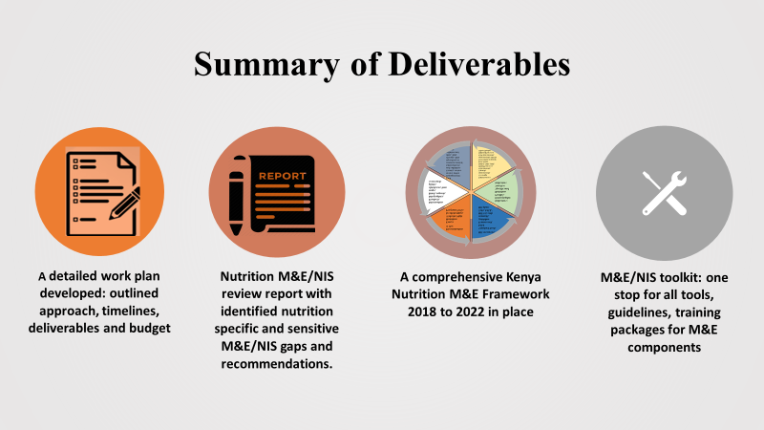
Development process
Stakeholder consultations: national and county govt, donors, development and implementing partners
Deliberation at various TWGs/ task groups
Framework builds on learning, success, lessons of the 2012-2017 NNAP and 2013 M&E Framework
Anchored on ideals of the Kenya Food and Nutrition Security Policy that are unpacked in the KNAP 2018-2022

Slide 5
Review of the 2012-2017 NIS/M&E System
Progress:
Commendable progress in establishing a functional nutrition information system though gaps exist especially in monitoring implementation of nutrition plans and programs at process level.
Challenges:
Limited funding for M&E activities such as technical supervision, capacity development, conducting of review forums and integration of technology in the M&E system
Understaffing and inadequate capacity for nutrition and M&E programmes both at the national and county levels
Gaps in technical knowledge in M&E as a result of inadequate capacity development and technical supervision
Inefficient M&E practices such as delayed dissemination of information and inadequate utilization of data
Inadequate stakeholder co-ordination for M&E and accountability mechanisms
Desk review
Stakeholder consultations: interviews multi-sectoral
Online survey
Recommendations
Strengthen and improve the quality of the KHIS data, in terms of comprehensiveness, reporting and utilization
Strengthen M&E of 2018-2022 KNAP by ensuring implementation of mid-term and end-term reviews
Strengthen operational research to inform programming
Improve implementation of the M&E system and NIS by improving multi-sectoral coordination, technical supervision, capacity building on M&E and NIS, dissemination and utilization of M&E data
Put in place a central repository for all NIS tool/kit for easy accessibility

Slide 6
Purpose of the Nutrition M&E Framework
Associated indicators and toolkits: identified performance indicators with clear definitions, thresholds, milestones, data collections methods, and frequency of collection
A harmonized approach and understanding of nutrition M&E
M&E framework serves as a plan for monitoring and evaluation and clarifies:
A comprehensive M&E guidance
The framework puts in place:
What is to be monitored and evaluated
The activities needed to monitor and evaluate
Who is responsible for monitoring and evaluation activities; Defined roles and responsibilities of different players and levels in the M&E system
When monitoring and evaluation activities are planned
How monitoring and evaluation are carried out
What resources will be required

Slide 7

Goal and Objectives of the M&E Framework
To institutionalize the application, use of M&E in nutrition and related sectors for policy planning, programme implementation and budgeting, and serve as an accountability and learning framework for nutrition stakeholders.
1. To provide guidelines on data collection, reporting, feedback
2. To monitor and evaluate quality of nutrition data and activities.
3. To monitor the health sector’s response to nutrition.
4. To produce and disseminate programmes implementation reports
5. To produce and promote data for decision making & programming
6. To provide an accountability and learning framework
7. To strengthen the nutrition information
9. To facilitate tracking and evaluation of performance of set targets
8. To develop a supervisory framework
10. To provide a framework for the systematic linkage of nutrition and food security
11. To strengthen the operational research capacity and coordination mechanism

Slide 8
Guiding Principles for the M&E Framework
Decentralization, analysis and storage of
data
Gender & disability mainstreaming, attention to vulnerable groups & regional disparities
Participatory and consultative approach
Mainstreaming of M&E in all interventions at all levels
Three Ones Principle
One national coordinating authority
One agreed comprehensive Kenya nutrition plan of action.
One agreed country level nutrition M&E framework
Adherence to standards and M&E ethics
Review and validation of the products in the existing relevant structures
Integration & complementarity to existing M&E systems
Efficient use of resources

Slide 9
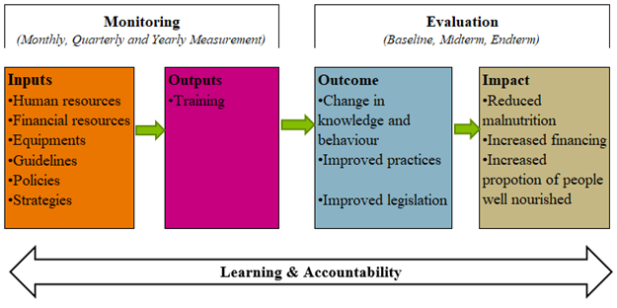
The Nutrition M&E Framework Logical Framework
MONITORING- will include routine collection and analysis of data to track progress against set plans and check compliance to established standards
EVALUATION- will include periodic assessment of the design, implementation and results of nutrition interventions/programs.
ACCOUNTABILITY- will be mainstreamed to ensure service providers or duty bearers are accountable for resources and results
LEARNING- the process through which information generated from M&E will be reflected upon and intentionally used to continuously improve the action plan/strategy to achieve results
Notes:
Monitoring of the KNAP activities and results will be done through routine collection, collation, analysis, interpretation and dissemination of data using standardized tools and procedures.
The frequency of monitoring the activities - monthly, quarterly and annually as outlined in the reporting frequency in the results framework.
Monitoring of implementation of programmes will focus on inputs and activities, whereas results monitoring will focus on outputs and outcomes and finally situation monitoring will focus on the status of nutrition, for example undernutrition among under five-year children in Kenya.
Each County to have developed context specific CNAP aligned to the KNAP. Each county will have an M&E Framework within the CNAP to guide the monitoring and evaluation of the programmes in the plan; counties to also monitor activities monthly, quarterly and annually and document the findings.
Detailed process monitoring indicator matrix for each KRA is presented in the M&E Process Monitoring Template uploaded at the MOH nutrition website http://nutritionhealth.or.ke.resources for easy access.
Mid -term review: A midterm review (MTR) of the 2018-2022 KNAP will be done in 2020 to review the progress made in the two years of implementation and recommend adjustments in strategy or review of expected targets if deemed necessary. It will also be aligned to the health sector strategic plan midterm review.
End term evaluation: The end-term review (ETR) of the Kenya Nutrition Action Plan will be done in 2022 to evaluate the overall performance of the KNAP and use lessons learnt to develop the subsequent KNAP and review the final achievements of the sector against what had been planned.
Specific programs evaluations – This will focus on specific interventions, policy, strategy etc.

Slide 10
Common Results Accountability Framework (CRAF)
A set of key indicators and targets as agreed upon during the development of KNAP 2018-2022 to measure progress of achievement of the strategies outlined in the plan.
The CRAF uses a logical results framework process at three levels (impacts, outcome and output).
S/N | KNAP expected results (Global targets used where applicable) | Indicator | Baseline 2014 | Target 2022 | Framework for targets
1 | Reduce the prevalence of stunting among children under five years by 40% | Prevalence of stunting in children 0-59 months (%) | 26 KDHS 2014 | 17 | WHA target 1 NFNSP-IF
2 | Reduce the prevalence of anaemia in women of reproductive age by 30% | Prevalence of anaemia in women 15-49 years (%) | 27 KDHS 2014 | 17 | WHA target 2 NFNSP-IF
3 | Reduce the prevalence of low birthweight by 30% | Prevalence of low birth weight of 2.5 kg and below (%) | 8 KDHS 2014 | 5 | WHA target 3
4 | No increase in childhood overweight/obesity | Prevalence of overweight/obesity (W/A >2SD) of children 0-59 months (%) | 4 KDHS 2014 | <4 | WHA target 4 & NFNSP-IF

Slide 11
Indicators by Key Result Area of the KNAP
Each KRA has an outcome with several outputs (expected results) and their respective indicators
Frequency of monitoring is based on the indicator level (impact, outcome and output) and source of information
Some indicators may have more than one means of verification hence overlapping frequency and multiple sources of information
OUTCOME 1: KRA 1 – MATERNAL, NEONATAL INFANT AND YOUNG CHILD NUTRITION (MNIYCN) |  |  |  | Strengthened care practices and services for improved maternal, newborn, infant and young child nutrition
Output | Expected Results | Indicator | Baseline | Mid Term | End term | Means of verification | Frequency | Lead | Associated
Output 1.1 | Increased proportion of mothers and care givers who practice optimal behaviors for improved nutrition of women of reproductive age (15-49 years) | Proportion of population with an acceptable household food consumption score (FCS). | 88.8% (KDHS 2014) | 92% | 95% (KDHS 2014) | KDHS Report Nutrition SMART Surveys | 3-5 years | MOH | Partners KNBS
Output 1.2 | Increased proportion of care givers who practice optimal behaviors for improved nutrition of young children under five years | Percentage of children born in the last 24 months who were put to the breast within one hour of birth | 62% (KDHS 2014) | 68% | 70% (KDHS 2014) | KDHS Report MIYCN KABP surveys | 3-5 years | MOH | Partners KNBS
Notes:
The KNAP is further organized into three focus areas: Nutrition-specific, Nutrition-sensitive & Enabling environment. Within the three focus areas are a set of key results areas with corresponding outcomes, outputs, strategies, interventions and activities that are further costed and presented within an implementation matrix.

Slide 12
Implementation Matrix
Defines activities and sub-activities and timelines for monitoring, evaluation, monitoring and learning
A Snap shot of the Operation Research Implementation Matrix
Key Performance Indicators | Activities | Sub Activities | 2018/19 | 2019/20 | 2020/21 | 2021/22 | 2022/23
Expected Output: Strategic partnerships and linkages developed
Number of New Strategic Partnerships established annually | Map out all the partners and networks including research institutions, universities, ethical research committees etc. that conduct research | Desk review to map partners and identify expertise | X | X | X | X | X
Expected Output: Linkages on research in nutrition strengthened
Number of existing partnerships strengthened by 2022/23 | Identify expertise for research in nutrition from existing partnership | RNTWG meetings | X | X | X | X | X
Expected Output: Research priorities identified through established Linkage between county and national government and other sectors;
Number of new research priorities identified annually | Desk reviews | RNTWG meetings | X | X | X | X | X

Slide 13
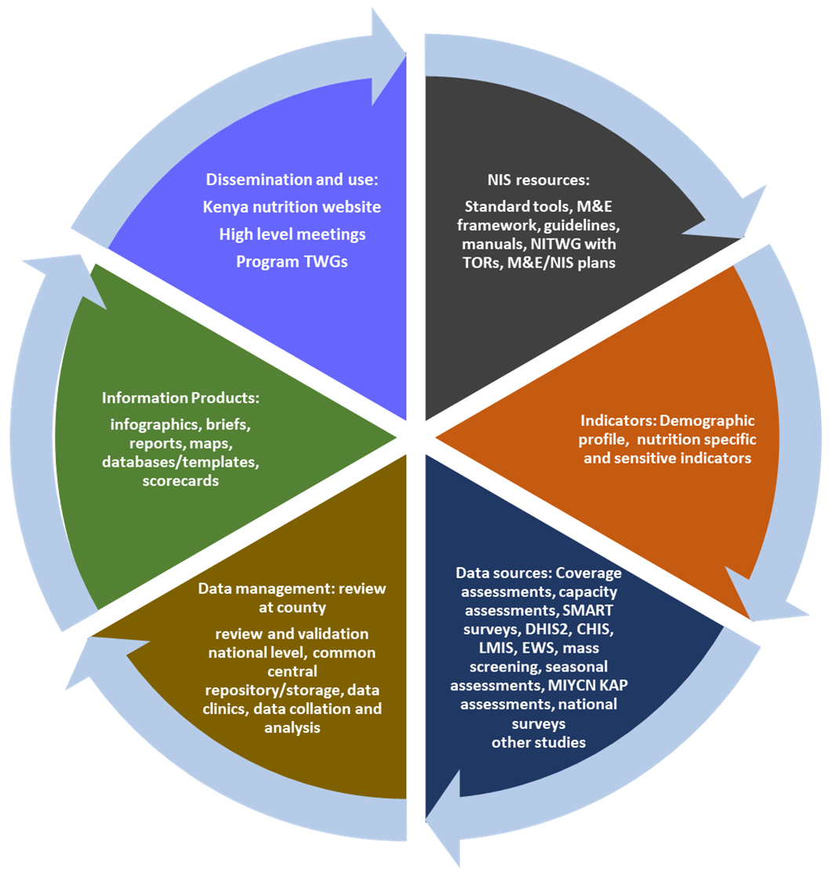
Components of the Nutrition Information System

Slide 14
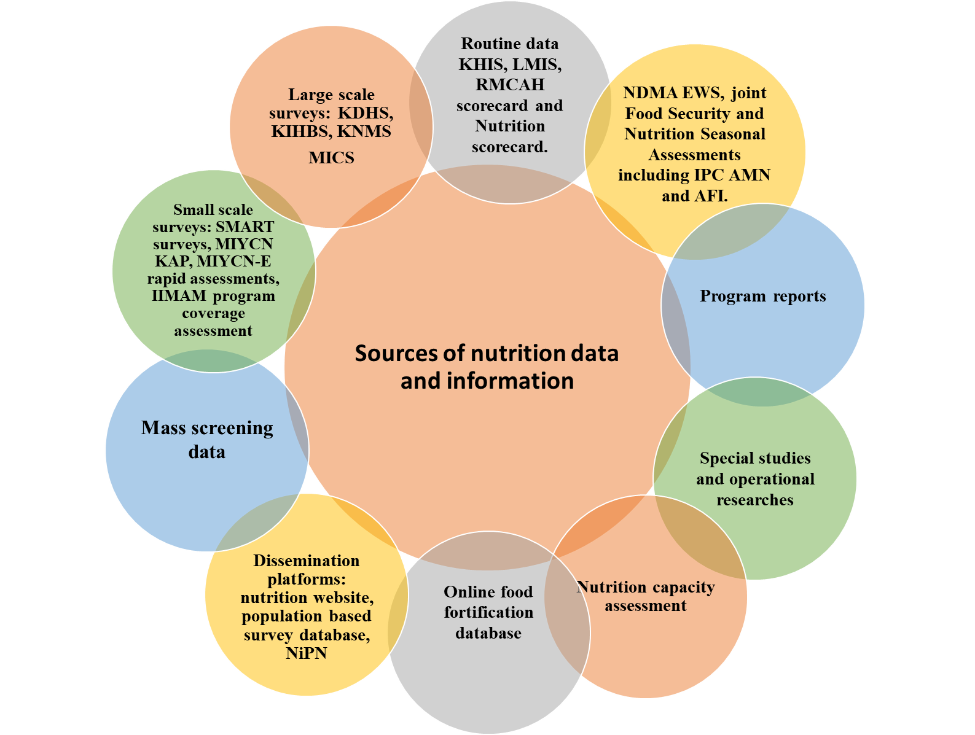
M&E Toolkit
Comprises of updated;
Training materials
Technical guidelines
Manuals
Forms
Registers
Report templates
http://www.nutritionhealth.or.ke/resources/
Access

Slide 15
Capacity Development for nutrition information management and M&E
  Kenya Nutrition Capacity Development Framework will guide capacity development for nutrition information and M&E.
  System wide capacity for nutrition M&E
Updating of the Framework
  The life of this framework is 5 years, in line with the KNAP 2018-2022.
  Regular update of the M&E plan will be done based on modification and/or inclusion of new interventions into the Division of Nutrition and Dietetics.
  A mid-term review of the framework will be done to measure progress of its implementation and make necessary amendments
Technical Coordination Mechanisms
Funding and resource mobilization

Slide 16
Nutrition indicators thresholds
Indicator Compendium
Indicators for assessing VAS coverage
Good Practice Template
Research Proposal Guide _ Technical Working Group
Monitoring and Evaluation products and Feedback mechanisms
Formats for presenting reports for Annual work Plans
Detailed cost of Monitoring and Evaluation Framework
List of contributors

Slide 17

Roles and Responsibilities of Stakeholders
Division of Nutrition and Dietetics
Line Ministries/Institution and Agencies including KNBS, KEMRI
Development Partners
County Health Management Team
Sub County Health Management Team
Health facility
Community Unit

Slide 18


Thank you for listening

